Slide 1



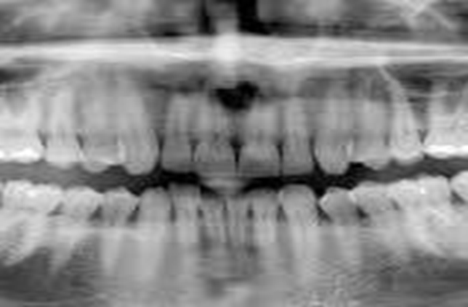
A Framework for detecting dental anomalies using segmentation, deep learning, few-shot learning, and meta learning techniques
Aly Essam – 221071 CS
Mohaned Gamal – 222035 CS
Under supervision of dr.Ayman Ezzat and Eng.Mahmoud Daker

Slide 2
Agenda
Introduction and context
Solution
Demo And results
References
conclusion

Slide 3
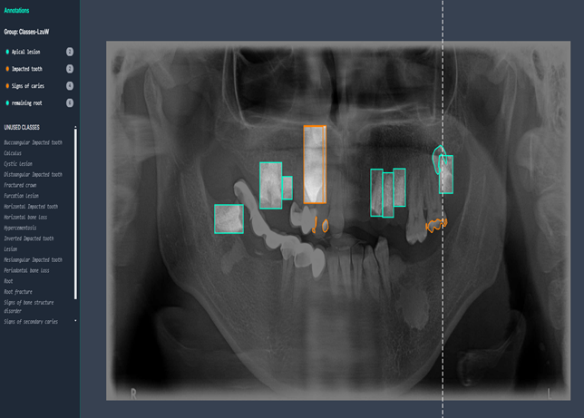
Introduction 1/2
Dental anomalies pose dangerous consequences if undetected.
Dentists had diagnostic agreement rates as low as 40-60% when assessing subtle conditions such as early caries or mild periodontal disease.
Diseases in teeth could be detected using panoramic x-ray images.
American Dental Association. (2002). Management of initial carious lesions. The Journal of the American Dental Association, 133(11), 1579-1587. https://doi.org/10.14219/jada.archive.2002.0083
Dataset link: https://universe.roboflow.com/gozdes-projects/dental-x-ray-1imfs

Slide 4

Introduction 2/2
Segmentation has various challenges (occlusion, similarity, overlapping …etc.).
The main obstacle is the diversity of dental anomaly types.
The lack of data set cause a great challenge.

Slide 5
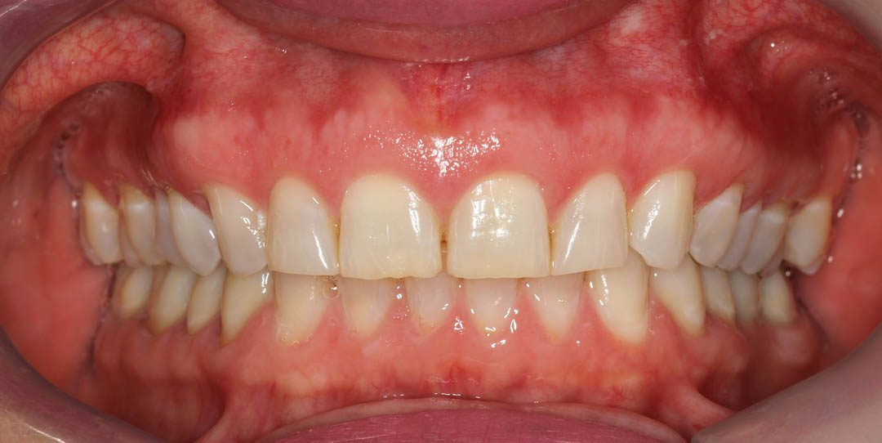



Slide 6
Motivation1/2
Doctors' Perspective
Enhanced Diagnostic Accuracy: The system aids in identifying dental anomalies with higher precision.
Time Efficiency: Automates segmentation and detection, reducing time spent on manual evaluations.

Slide 7
Motivation2/2
Patient prospective
Early Detection: Identifies anomalies at initial stages, preventing serious dental complications.
Faster Service: Streamlined diagnostics mean shorter waiting times for treatment plans.

Slide 8
Problem statement
Detection accuracy is low.
Choosing best model that fits the data require huge computational process and time consumption.
There is too many dental anomalies types that cause shortage of data.

Slide 9
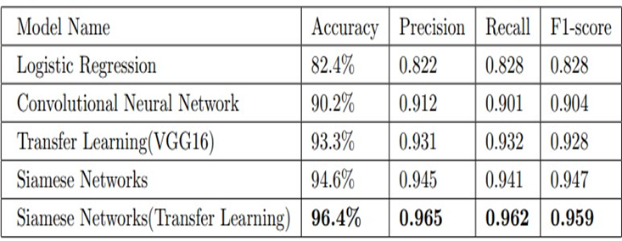
Jadon, S. (2021, February). COVID-19 detection from scarce chest x-ray image data using few-shot deep learning approach. In Medical imaging 2021: Imaging informatics for healthcare, research, and applications (Vol. 11601, pp. 161-170). SPIE.
Related work 1/2
Approach:
Applying data augmentation techniques (zooming, shearing, and rotation) on the data.
Methodologies:
1) Few-Shot learning: Using Siamese Network.
2) Combination between Transfer learning and Few-Shot learning
Evaluate the previous models using: Accuracy, F1-score, Precision, Recall, and Silhouette Score, the results is shown in Fig.1.
Limitations:
1) Data scarcity.
2) Some of the data may not be represent the real-world data distribution, in this case the model well be biased.

Slide 10
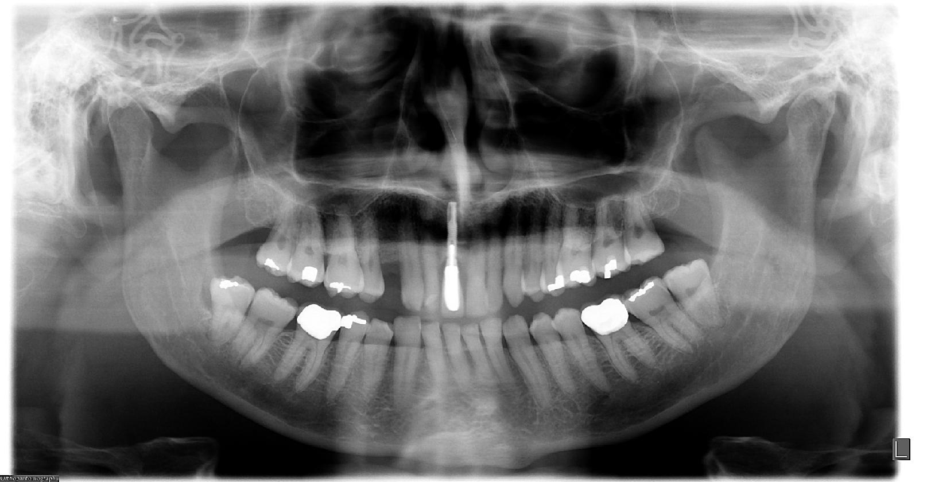
Problem 1/3
A gender classification problem from panoramic X-ray was solved using our methodology.
Handling Small Amount of Data
Increasing Accuracy using Ensemble learning

Slide 11
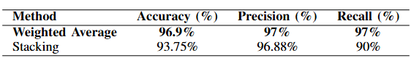
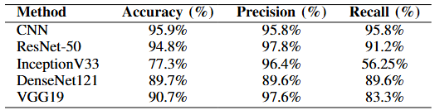
Results 1/2
Applying CNN model, VGG, Resnet, Inceptionv3, DenseNet, all were fine-tuned
Applying ensemble models (weighted average, Stacking), combining the best three models(CNN, ResNet-50, and VGG19) to increase accuracy

Slide 12
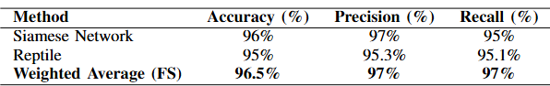
Results 2/2
Applying Few-Shot learning (Siamese, reptile), dealing with a small amount of data
Ensemble the two few-shot learning models using the best ensemble model from the past experiment (weighted average), to enhance accuracy

Slide 13


Publication
Published a paper in the 7th International Conference on Activity and Behavior Computing, with title: Gender Classification in Panoramic Dental X-Rays using Few-shot Learning and Ensemble Model

Slide 14
Problem 2/3
Enhancing the resolution of our dental panoramic X-ray dataset using ESRGAN.
Applying Keras tuner to get the best architecture for our models.
Applying four types of ensemble learning models to increase accuracy

Slide 15
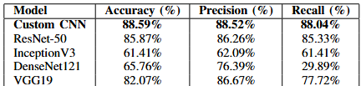
Results 1/2
Training CNN model (from scratch), VGG, Resnet, Inceptionv3, DenseNet, all were fine-tuned
Enhancing the resolution using ESRGAN showed an effective increase in accuracy by 2%

Slide 16
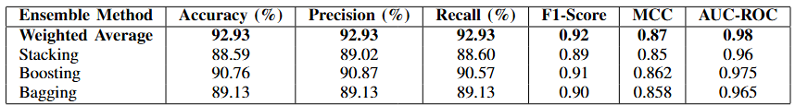
Results 2/2
Applying ensemble models(WeightedAverage, Stacking, Boosting, and Bagging) to increase accuracy by combining the best three models(CNN, ResNet-50, and VGG19).
Applying different methodologies for each model to get the best outcome from it

Slide 17


Publication
Published a paper in the IMSA conference, with the title: Automated Diagnosis of Dental Conditions in Panoramic X-Rays with Ensemble Deep Learning Models

Slide 18
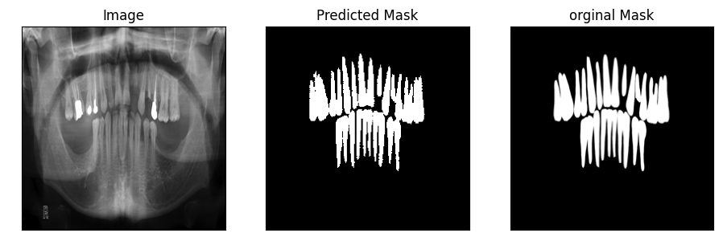
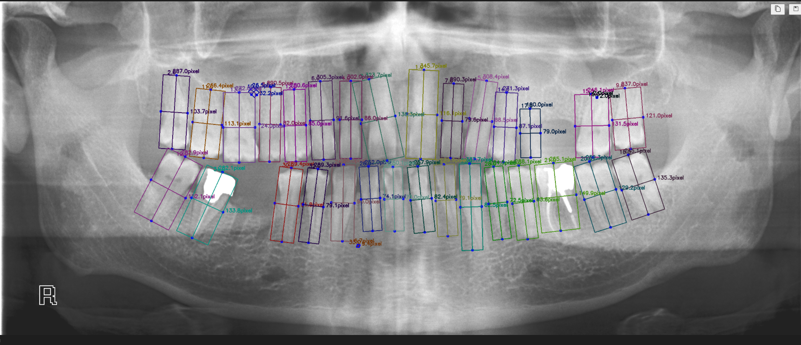
Problem 3/3
Applying segmentation to get each tooth for the unlabeled X-rays.
Applying few-shot learning(seamise, reptile), and vision transformers for small data sets, to deal with the limitation of data.

Slide 19
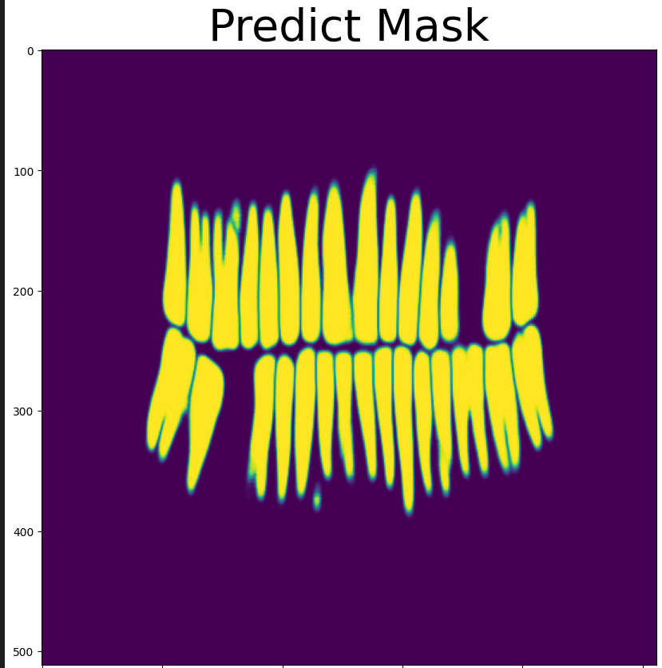
Results 1/3
For segmentation, we applied two methodologies: U-Net, SAM(fine-tuned)
The dataset for training consisted of panoramic X-ray images and the corresponding masks.
The U-Net was better in accuracy, achieving 95%, with 0.03 loss
The SAM achieved 86%, with 0.08 loss

Slide 20
Results 2/3
Applying Few-shot learning models(Siamese, Reptile) with Keras Tuner to give us the best architecture with 95 trials,
Vision transformers on a small dataset were applied (vit,vit_sl), dealing with data scarcity
The best few-shot learning model was Siamese, and the best vision transformer model was vit_sl(Shifted Patch Tokenization and Locality Self-Attention).
Model | Accuracy
Siamese | 86%
Reptile | 60%
vit | 89%
Vit_sl | 90%

Slide 21
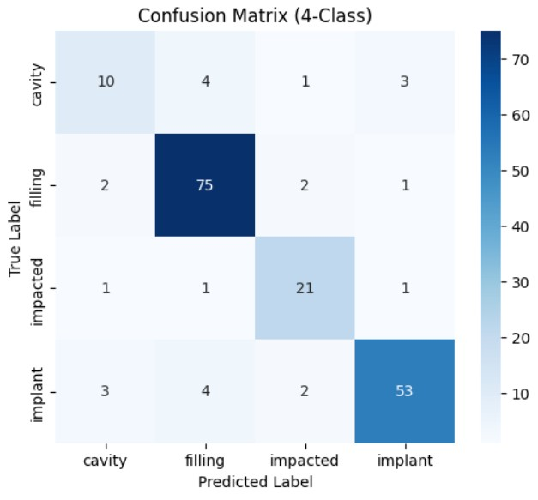
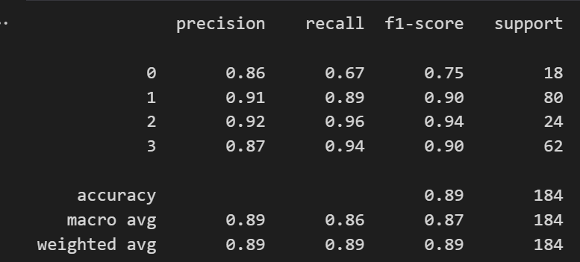
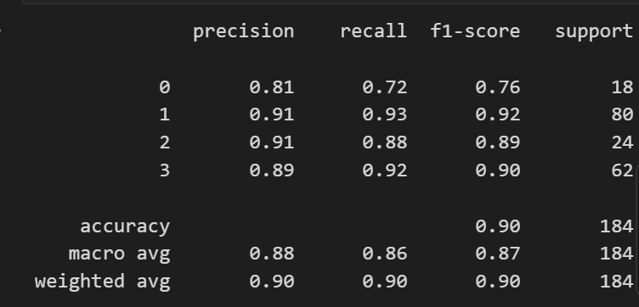
Results 3/3

Slide 22
Demo

Slide 23
Conclusion
Few-shot learning showed efficiency on limited data
Our best few-shot learning until now is a Siamese network with: 86%
The ensemble enhanced the accuracy of the best models
Compared to the paper results are much improved

Slide 24
Thank you

Slide 25
Any Question?

Slide 26
Reference
Jadon, S. (2021, February). COVID-19 detection from scarce chest x-ray image data using few-shot deep learning approach. In Medical imaging 2021: Imaging informatics for healthcare, research, and applications (Vol. 11601, pp. 161-170). SPIE.
Jadon, S. (2021, February). COVID-19 detection from scarce chest x-ray image data using few-shot deep learning approach. In Medical imaging 2021: Imaging informatics for healthcare, research, and applications (Vol. 11601, pp. 161-170). SPIE.
Cauás, Nathália & Millan-Arias, Cristian & Brito, Débora & Mota, Cláudia & Fonseca, Márcia & Rosenblatt, Aronita & Fernandes, Bruno. (2023). Detection of Cavities in Radiographs Using Machine Learning: Approaches for Limited Data. 1-6. 10.1109/LA-CCI58595.2023.10409414.
A. Ayman, S. W. Arafat, A. M. H. Eldin and A. Atia, "Dental implant recognition and classification with Convolutional Neural Network," 2022 2nd International Mobile, Intelligent, and Ubiquitous Computing Conference (MIUCC), Cairo, Egypt, 2022, pp. 477-482, doi: 10.1109/MIUCC55081.2022.9781715.

Slide 27
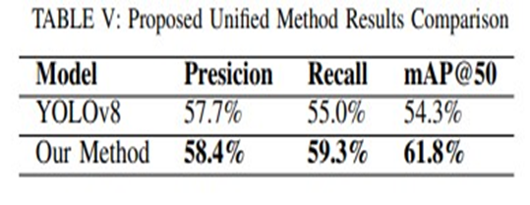
Related work 2/2
Approach:
Preprocessing the data to enhance the quality and the quantity through data augmentation, transformation, and filters.
Methodologies:
1) the YOLOv8 medium model with fine-tunning was applied, in collaboration with a post-processing technique, to detect, number and crop each tooth
2) a YOLOv8 model was applied to detect and segment cavities and restoration in every single tooth.
3) a Detectron2 model was applied to the same task as YOLOv8.
4) step 1 and (the best of step 2 and step 3), which is Yolov8, were integrated to build up a unified model to enhance the accuracy.
Evaluate this unified model using: Precision, Recall, F1-score, IoU, and mAP.
Limitations:
1) Data scarcity.
2) achieving low accuracy.
3) the confusion in YOLOv8 model that caused by the symmetry of human mouth.
Ghahremani, T., Hoseyni, M., Ahmadi, M. J., Mehrabi, P., & Nikoofard, A. (2023, December). Advanced Deep Learning-Based Approach for Tooth Detection, and Dental Cavity and Restoration Segmentation in X-Ray Images. In 2023 11th RSI International Conference on Robotics and Mechatronics (ICRoM) (pp. 701-707). IEEE.

Slide 28
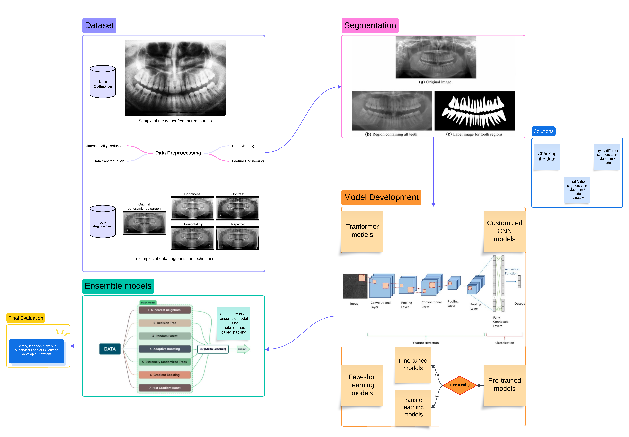
System Architecture
In collaboration with Dr. Ahmed Hossam, Dr. Hussin Gamal, Dr. Omar Essam, And other sources from the internet to provide our project with enough data to use.

Slide 29
Data Set
The dataset is mainly from roboflow
It contains 4 classes (Cavity, Fillings, Impacted Tooth, Implant)
The Dataset folder is divided into Train, Test, and Validation

Slide 30

Input Data shape
Radiographic image: Panoramic x-ray.
The input image would be resized into 224x224.
Every tooth in the image would be segmented.

Slide 31
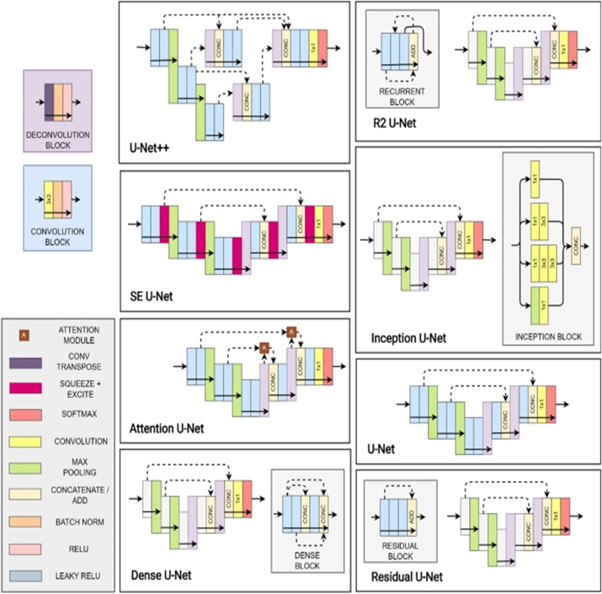
Details of used algorithms 1/5(1)
U-nets and SAM is used to segment data
U-net architecture

Slide 32
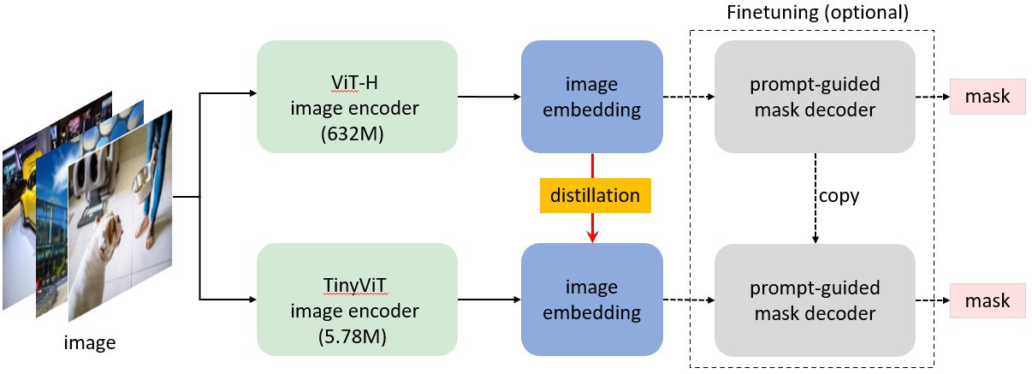
Details of used algorithms 1/5(2)
SAM architecture

Slide 33
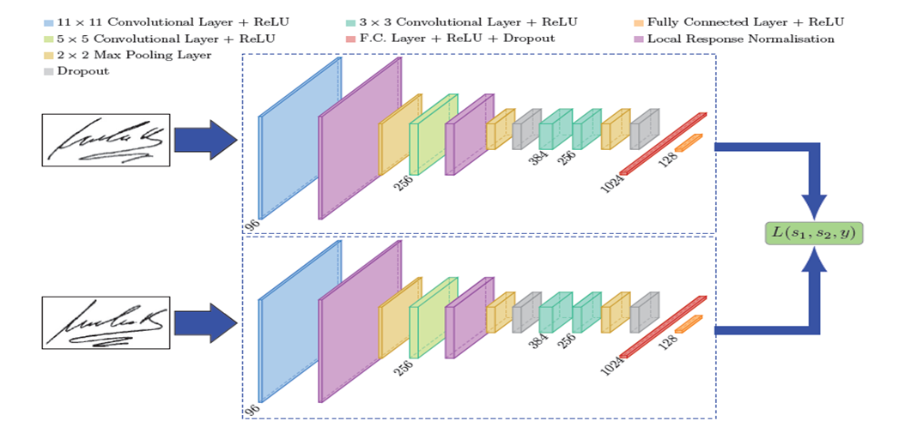
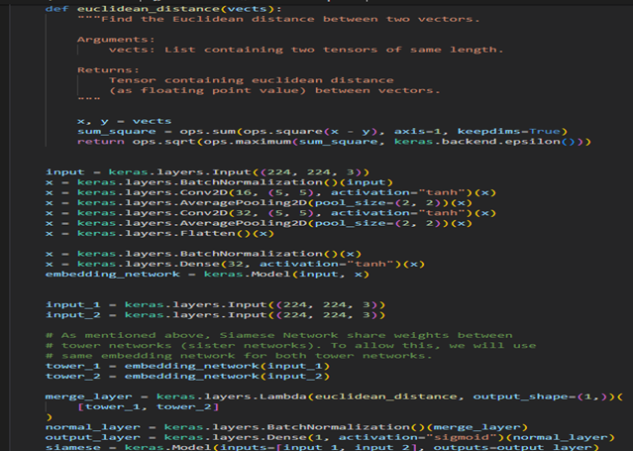
Details of used algorithms 2/5
Few-shot learning is essential when working on limited data.
Siamese network architecture
Siamese network implementation code

Slide 34
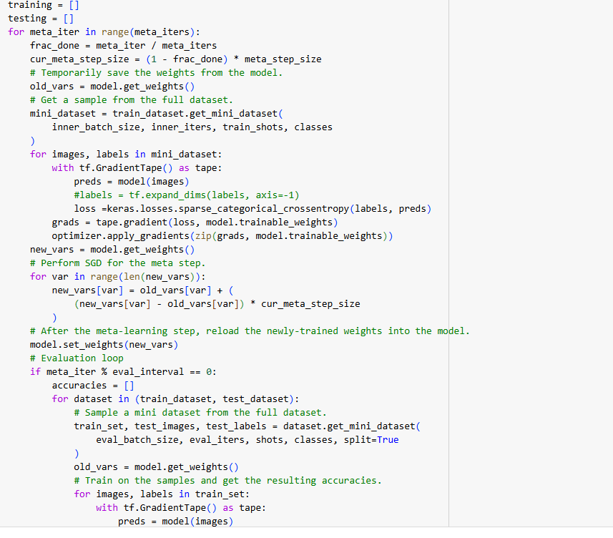
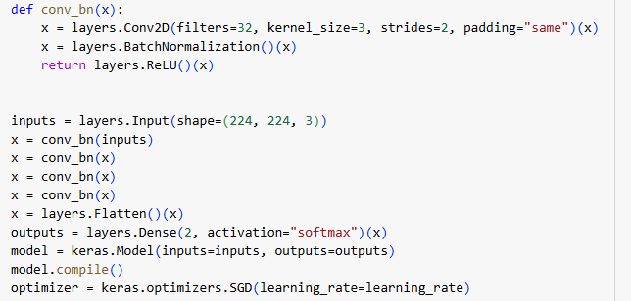
Details of used algorithms 2/5(2)
Using an algorithm like a reptile to face this challenge.

Slide 35
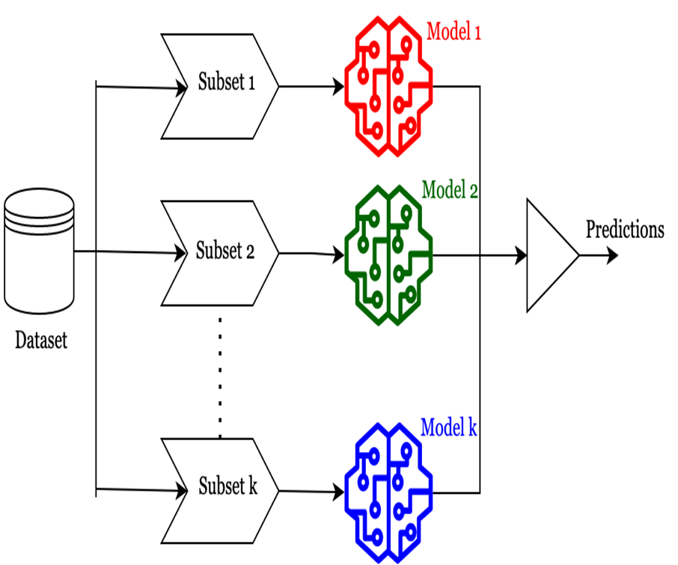
Details of used algorithms 3/5(1)
Combining the best deep learning models to make an ensemble model.
Trying different techniques of ensemble like bagging, stacking, weighted averaging, boosting.

Slide 36
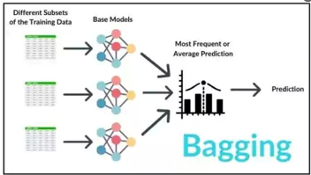
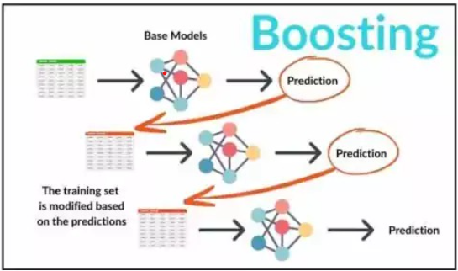
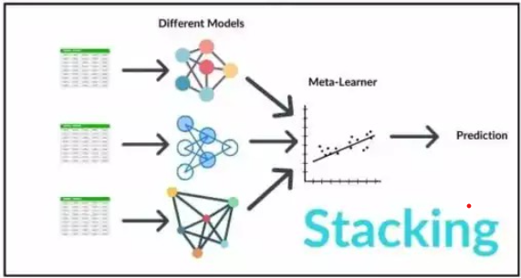
Details of used algorithms 3/5(2)
Ensemble models architecture, focusing on using meta-learner.

Slide 37
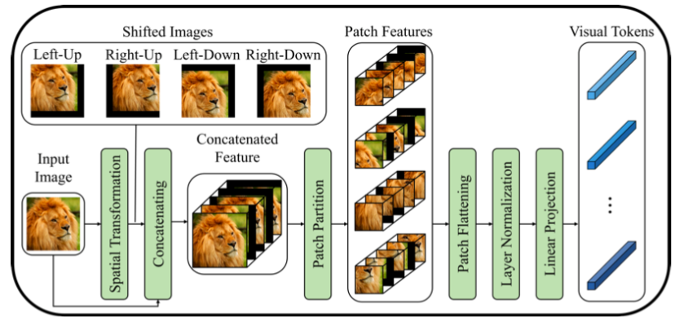
Details of used algorithms 4/5(2)
Vision Transformer on small datasets algorithm is used to face data scarcity

Slide 38
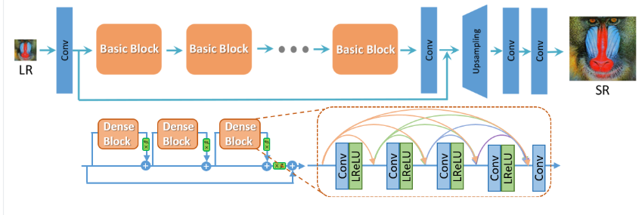
Details of used algorithms 4/5
Using EsrGan to improve the resolution of the images

Slide 39
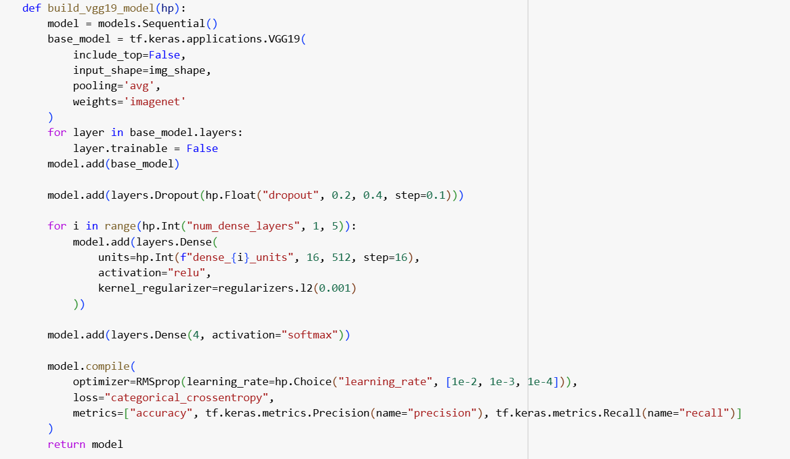
Details of used algorithms 5/5
Using keras tuner to get the best archticture for our models

Slide 40
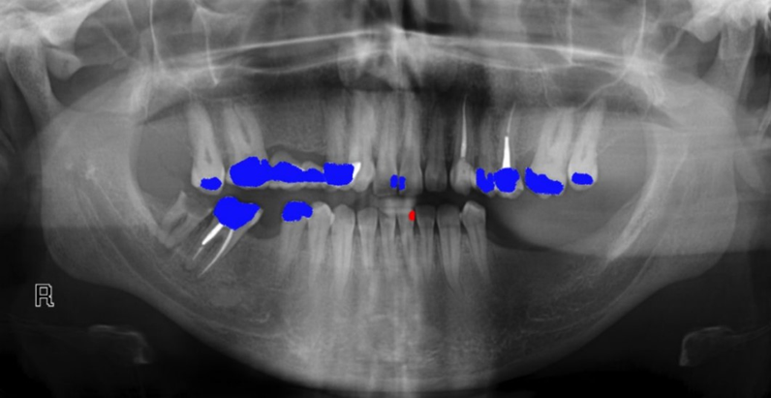
Expected output
An image with highlights of the places of each dental anomality type.

Slide 41
System evaluation
The performance of Deep learning models would be measured using accuracy, f1-score, recall and precision.
The performance of Segmentation algorithms would be measured using IOU.
Taking a feedback from the client and the expertise.

Slide 42
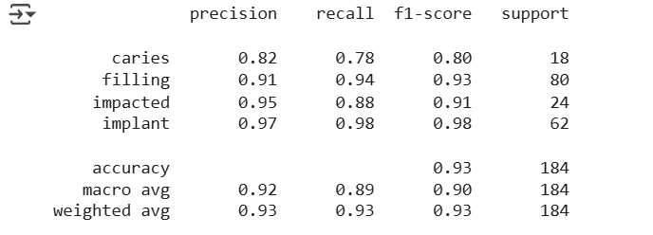
Demo 1/6
Image classification using the weighted average Ensemble model on the dataset using the three models (CNN,Resnet-50,VGG19) .
Achieving high accuracy with 92.9%

Slide 43
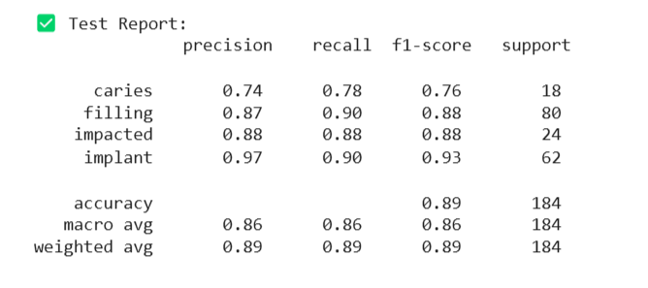
Demo 2/6
Image classification using the Stacking Ensemble model on the dataset on three models (CNN, Resnet-50, VGG19).
Achieving high accuracy with 88.6%

Slide 44
Demo 3/6
Using Boosting Ensemble model on three models (CNN, Resnet-50, VGG19)
Increasing the accuracy to 91%

Slide 45
Demo 4/6
Image classification using CNN, Transfer learning, and ensemble models (averaging) on the same dataset of demo 1/2.
Model | Accuracy
Cnn | 88.5%
Resnet_50 | 85.2%
InceptionV3 | 61.7%
DenseNet121 | 65.4%
Vgg-19 | 82.8%

Slide 46
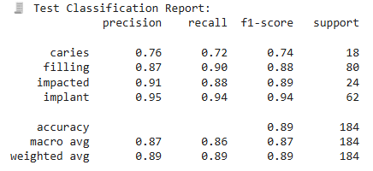
Demo 5/6
Results for ensemble bagging(Cnn,Resnet50,Vgg19)
Acheaving accuracy with 89.13%

Slide 47
Demo 5/6
Applying vit on small dataset algorithm on our data (Roboflow) panorama x-ray
Achieving accuracy of 89% for vit and 90% for vit_sl(Shifted Patch Tokenization and Locality Self Attention)

Slide 48
Ensemble model
Have two methods: basic one and advanced one
Basic one: max voting and averaging weights.
Advanced one: stacking, boosting, bagging, blending.

Slide 49
F1-score
It is the harmonic mean of precision and recall

Slide 50
Few shot learning algorithms
Prototypical networks: the model calculates the distance from each class prototype for the new example and assigns it to the nearest class
Matching network: the model compares a query example to examples in the support set using the similarity function
Siamese networks: Siamese networks involve two identical subnetworks that process two input images and learn to differentiate whether they belong to the same class.

Slide 51
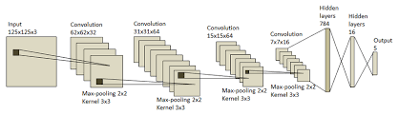
CNN
CNN consists of input, hidden, output layers
Finding the best weights Using forward pass and backpropagation
Convolutional, max pooling, and flatten

Slide 52
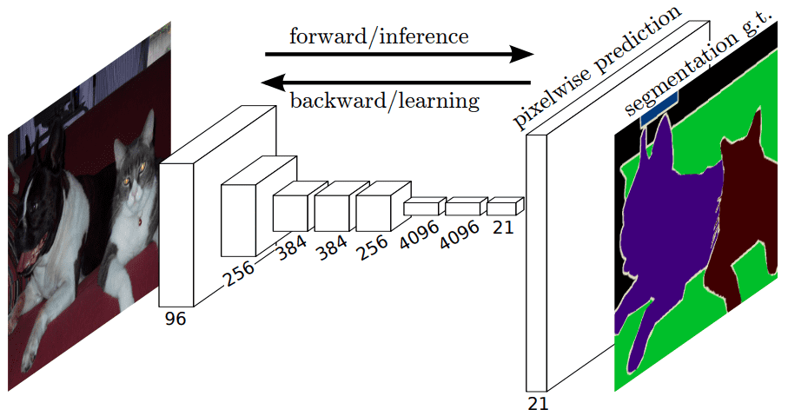
U-Net
U-Net is a convolutional neural network designed specifically for biomedical image segmentation.
Excellent for small datasets, which is common in medical imaging.

Slide 53
SAM
SAM can perform segmentation based on different types of inputs:
SAM has been trained on massive datasets with diverse image types and objects.
It is designed to segment anything like anatomical structures in medical images, such as teeth in X-rays.

Slide 54
Shifted Patch Tokenization
the input images are divided into patches that are then linearly projected into tokens. Shifted patch tokenization (STP) is introduced to combat the low receptive field of ViTs.

